Slide 1

Wireless Power Transfer
C1C Pak
C1C Singh
C1C Henry
C1C Hermanson
1

Slide 2
Overview
Executive Summary
Technical Discussion/Attack Vector Review
Sprint Organization
Motivation
Problem Statement
Key Sprint Accomplishments
Results
Challenges
Sprint 6
Future Work
Questions

Slide 3
Executive Summary
Review fundamentals of WPT and associated vulnerabilities.
Discussion of action items researched and completed throughout this Sprint.
Review significant developments and existing challenges related to the research.
Consider the next phase of research and look ahead at long-term goals of this Capstone Project.
Consider the long-term implications of this capstone project.

Slide 4
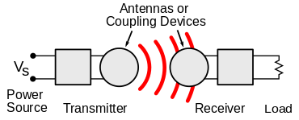
Technical Discussion
WPT is wireless point to point transmission of electrical energy
Many implementations but Qi is the industry standard
Alternatives: AirFuel, Proprietary Near Field Magnetic Coupling, RF, Ultrasound
Delivers a variable amount of voltage to device depending on power requirements (5-15 Watts)
New technology that lacks security capabilities and has vulnerabilities
Malicious messages can be sent between transmitter and receiver to alter power transmission
Messages between transmitter and receiver can be observed to gain information about receiver

Slide 5
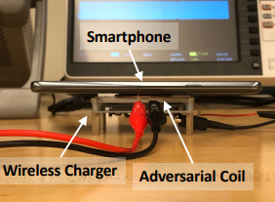
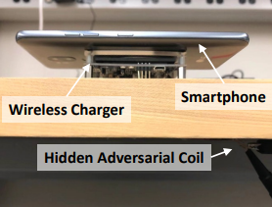
WPT Attack Vectors
Hijacking
Injection of adversarial magnetic signals on the power transmitter to hijack the communication channel
Disruption of magnetic field (via well crafted injection) between transmitter and receiver – cause inefficient power transfer
Control of power transfer process
Eavesdropping
Qi has lack of encryption and authentication mechanisms
Snoop communication between transmitter and receiver
Infer activity of receiver device
Q ID & C allows basic device identification

Slide 6
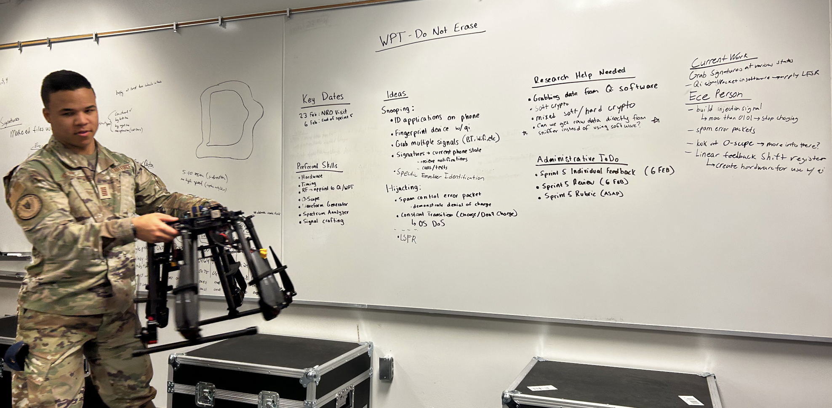
Sprint Organization
Utilized Jira Software to track the sprint process – No longer using
Research Organization:
(Discontinue Document in Teams)

Slide 7
Motivation
Wireless Power Transfer has become an industry standard being incorporated into more and more areas of technology
Personal Electronics, Healthcare Devices, Electric Vehicles
Exploit techniques and results found in this experiment can potentially be generalized
This research will create a foundation for further experimentation and TTP development
Findings expanded to other wireless non-networked point-to-point connections

Slide 8
Problem Statement
IDENTIFY
Vulnerabilities
How to exploit
How to defend
APPLY
Proof of concept – hijacking
Proof of concept – eavesdropping
Interpretation of results
EXPAND
Provide research to NRO
Observe various side channel-attacks
Create security mitigations – Software Based Encryption
Expand to larger technologies

Slide 9
Key Sprint Accomplishments
Qi Sniffer
Fingerprinting
Encryption
Demodulation Script

Slide 10
Qi Sniffer
Acquired the Qi Sniffer at the beginning of the sprint
Hardware issues
Correct hardware setup and limitations
Software issues
Sniffer did not arrive with copy of software
Customer support was less than helpful
Found a copy on Github and implemented it

Slide 11
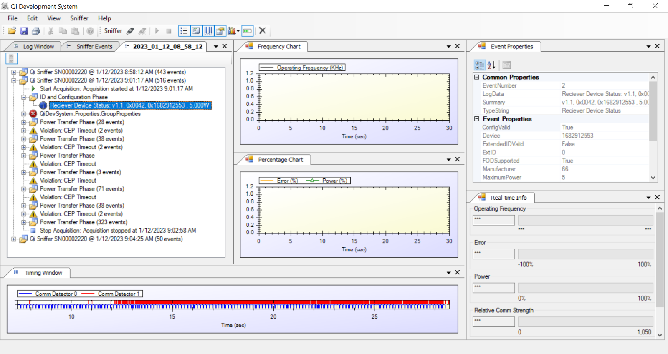
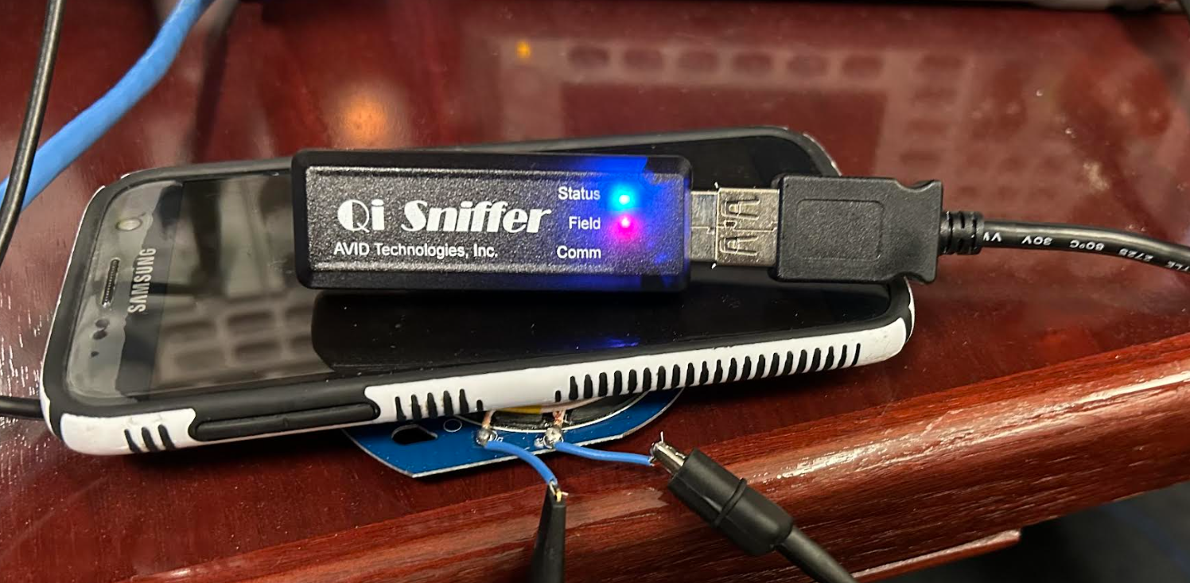
Qi Sniffer Continued
Qi Development System
Sniffer Events, Event Properties, Timing Window

Slide 12
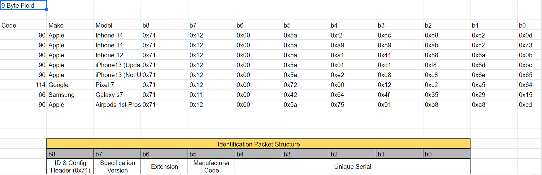
Fingerprinting
Using the Qi sniffer, acquired manufacturer and device data stored in the snooped bytes

Slide 13
Encryption
Researched possibilities and best courses of action
Began exploring the options presented by lightweight IoT encryption
Linear shift feedback registers
Stream Cipher

Slide 14
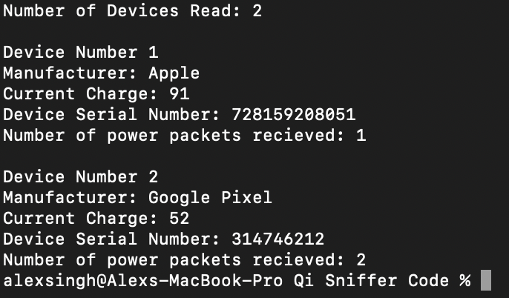
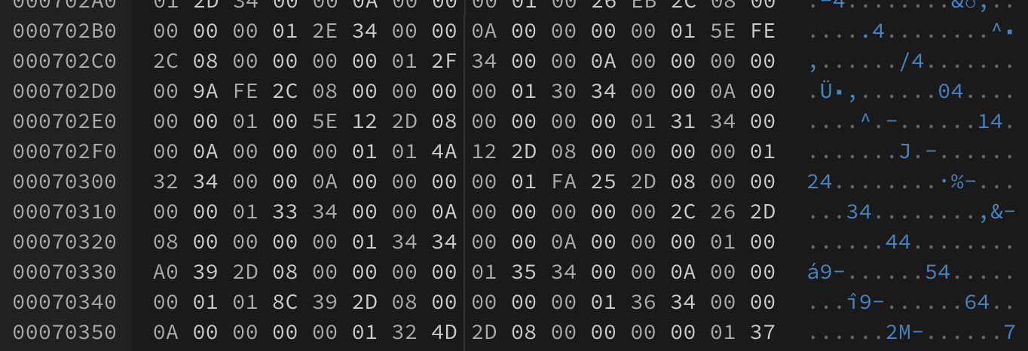
Fingerprinting Script
Data currently input by hand
Figuring out how to parse hex file
Looking to implement GUI

Slide 15
Data Collection
.qid file type
Hex data
Goal = .csv or .json
Manual collection
Would help visualization

Slide 16
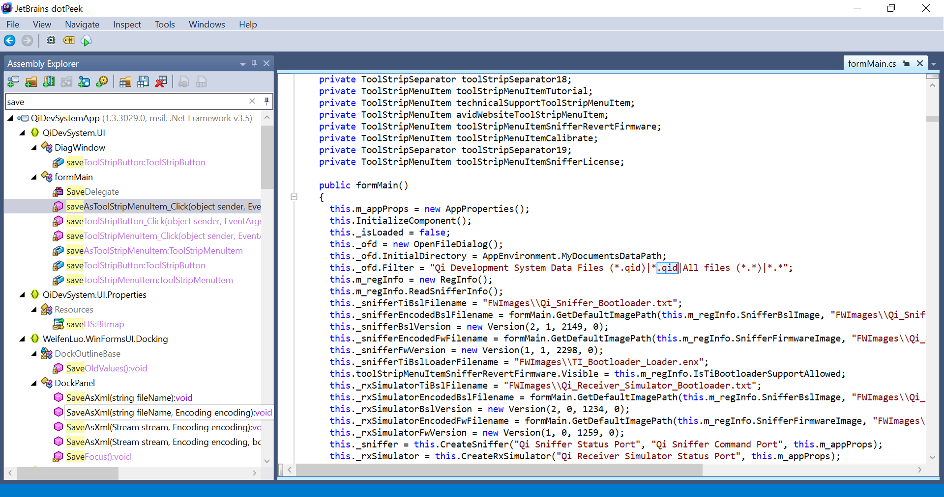
Data Collection Continued
JetBrains dotPeek

Slide 17
Results Summary + Discussion
Qi Sniffer is a very powerful tool we are very grateful for and are making great headway into uncovering the full potential of this device
Fingerprinting
Collected lots of data, will continue researching methods and means by which this can be accomplished faster/easier and what the potential of this vector is
Encryption
On the way to a proof of concept, foundation is laid
Fingerprinting Script
Hex File Parsing
GUI Development

Slide 18
Challenges
Qi Sniffer Initial Setup
QiD Filetype
ECE Injection Crafting
Qi Simulation layered with Encryption

Slide 19
Sprint 6 – Taskers/COA
Soft Encryption Development
Linear Shift Feedback Registers
Stream Cipher
Proof of Concept – simulation
Packet processing verification
(Packet Snooping and Injection mitigation)
Proceed with Fingerprinting
Signature data analysis and inference
Specific Emitter Identification
Constant Charge Transition (Charge/Don't Charge)
OS DoS
NRO Presentation

Slide 20
Future Work
Modification of Qi packets
Qi communication packets are interpreted on the receiver device, modification of the data component within the Negotiation Phase may allow code execution or data exfiltration on the receiver device
Applications with laser-based point-to-point communication
Non-networked systems
Development of Qi Protection Mechanisms
Hardware or Software based cryptography
Injection/packet modification detection
Applications Beyond Qi
Other protocols / different device focus
Healthcare device, embedded system components

Slide 21

Questions
20

